Slide 1
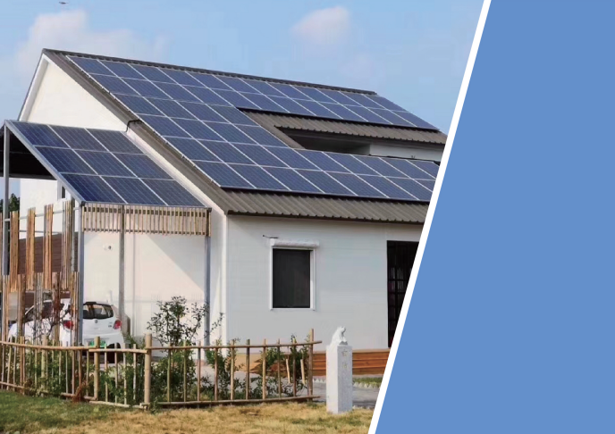
T.Y.L ®
CHANGE YOUR LIFE WITH TECHNOLOGY
GUANGZHOU TONGLI NEW ENERGY CO.,LTD.
Address: Yongxing industrial park, Longgui, Taihe town, Baiyun, Guangzhou
Website: http://www.tylsolar.com/ http://tylsolar.1688.com/
TEL: 13825085966 Manager Zhang
Email: tonglisolar@163.com

Slide 2

Catalogue
01
02
03
04
Company
Profile
Product
Category
Engineering Projects
Choose us

Slide 3
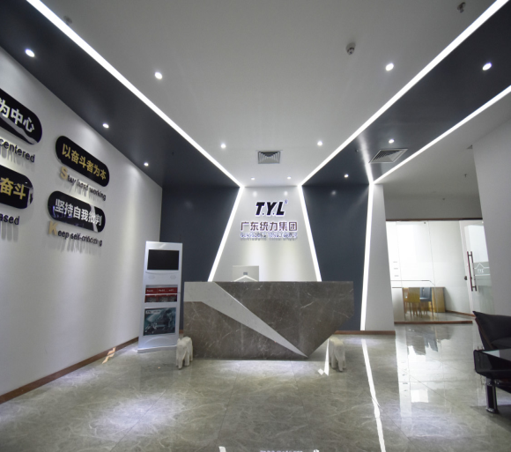
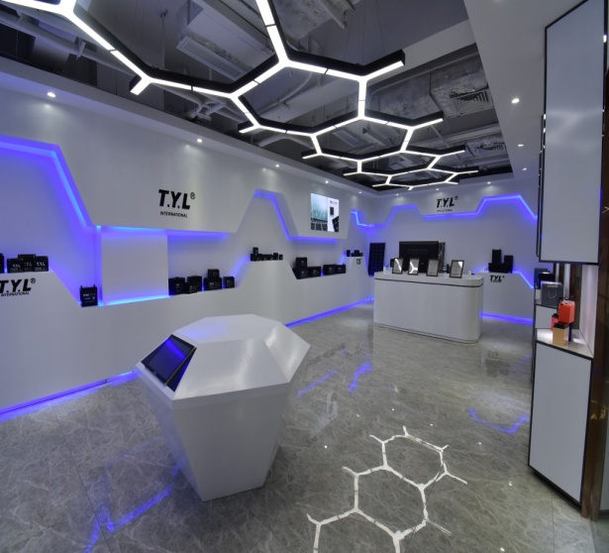
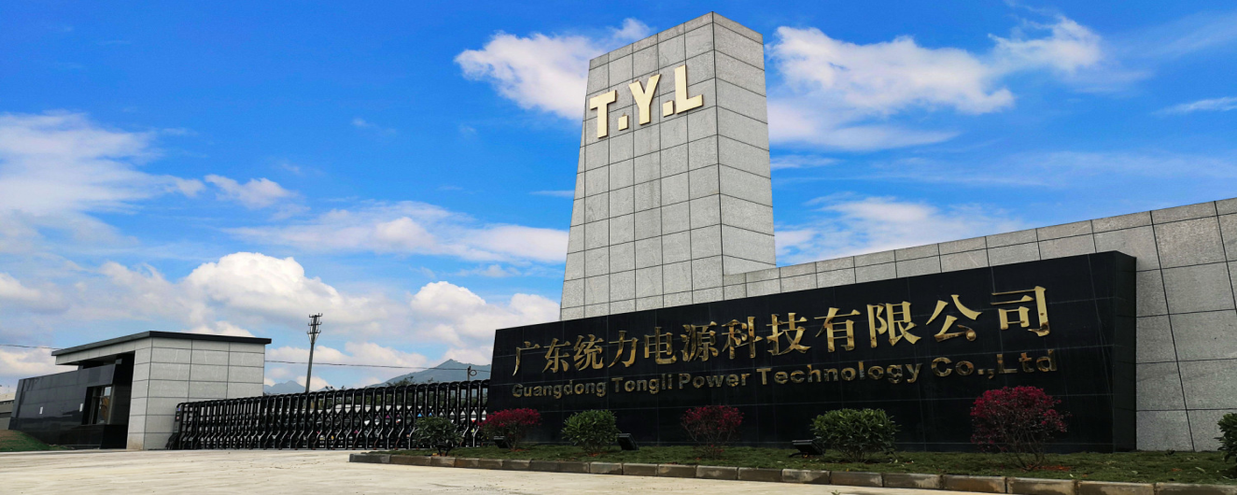
COMPANY PROFILE
Guangzhou Tongli New Energy co., LTD. belongs to Guangdong Tongli Group, which was founded in Guangzhou in 1999 by Dr Tony Tong, which is a comprehensive hi-tech enterprise of R&D, manufacturing and trade. The first company that is engaged in Solar Power system, Solar panels, Solar Gel Battery, Solar street light, Automotive battery, motorcycle batteries, motorcycle electrical parts in China. Headquartered in the international city of China-Guangzhou. Now we have three factories. Guangzhou factory with more than 500 workers, Covers an area of 40000 square meters, mainly develops and produces solar power systems. TongShi battery in Longgui Shaoguan, the factory covers an area of 60000 square meters, with more than 1000 workers, mainly develops and produces batteries. Tongli factory in Wengyuan shaoguan, the factory covers an area of 70000 square meters, with more than 800 workers, mainly develops and produces batteries. The Solar Power system, Solar panels, Solar Gel Battery, Solar street light, Automotive batteries, Motorcycle batteries and related electrical products are exported to major United States, Europe, Middle East, Africa, South America .
The Company and its products have achieved the certificates as UL,CE, IEC, ISO9001, ISO9008, ISO14001. Our trademarks T.Y.L have received a good reputation from our distributors and users. Our products serve LV, Mobike, CNPC,CSCEC and so on.. We are Dongfeng Automobile nominated supplier, Storage battery Manufacturing base. We believe in our product and we will be proud to serve you. In the future, we will take technical and market advantages fully, and further enhance the business capability and industry leading capability, join hands with our business partners from around the world for the prosperity of the global Solar power market to make new and greater contribution.

Slide 4

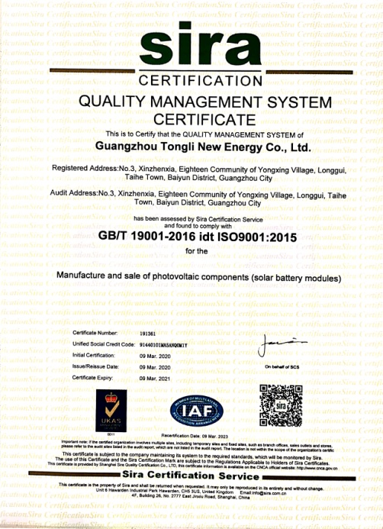
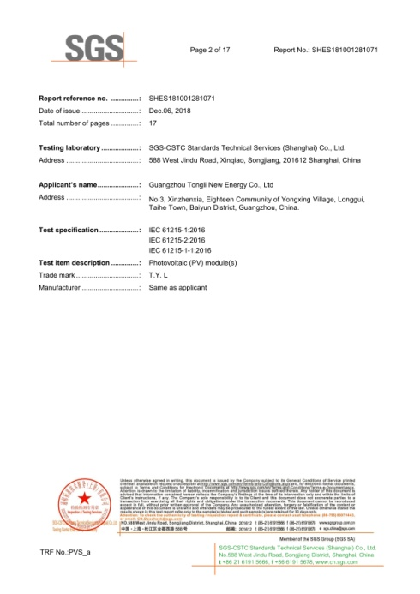
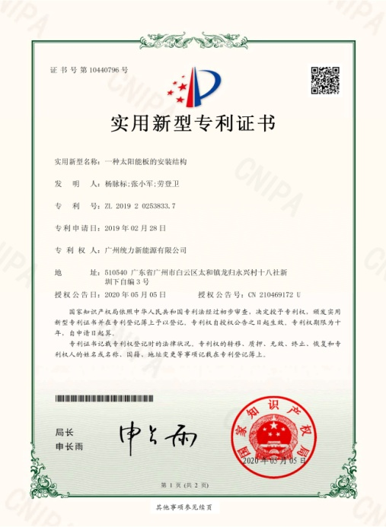
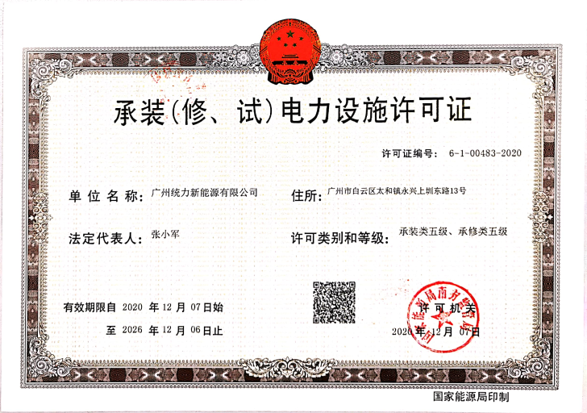
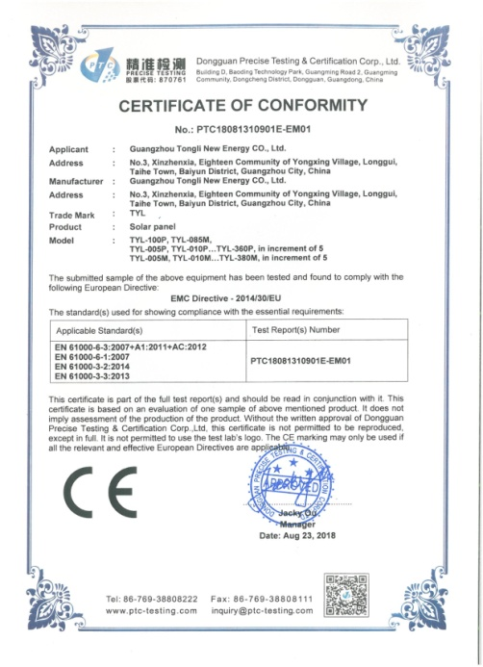
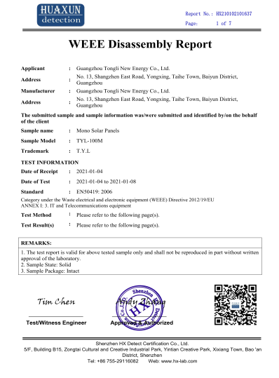
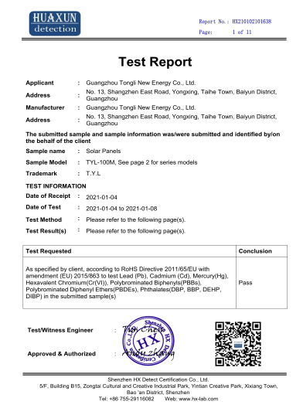
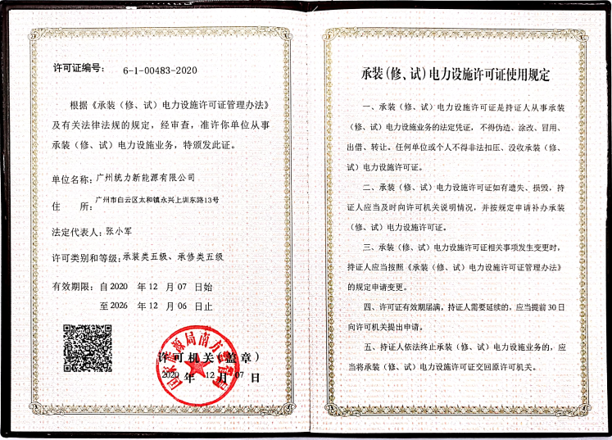





QUALIFICATION CERTIFICATE

Slide 5
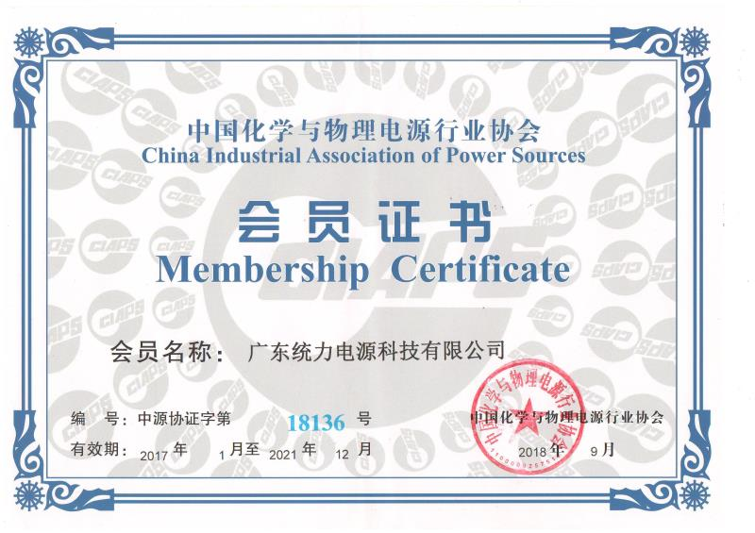


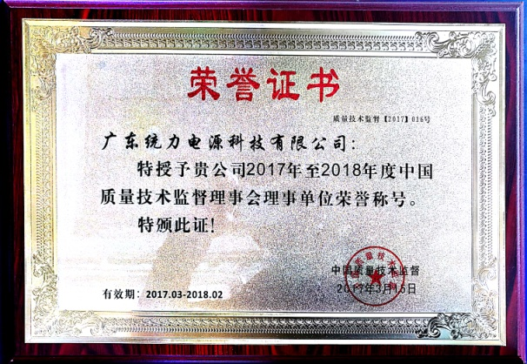





HONOR CERTIFICATE

Slide 6
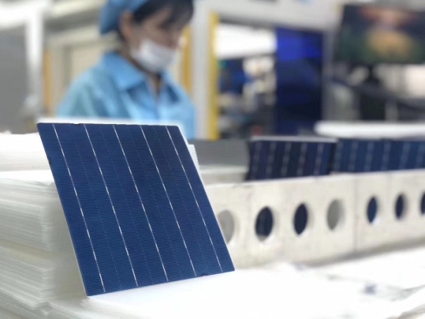
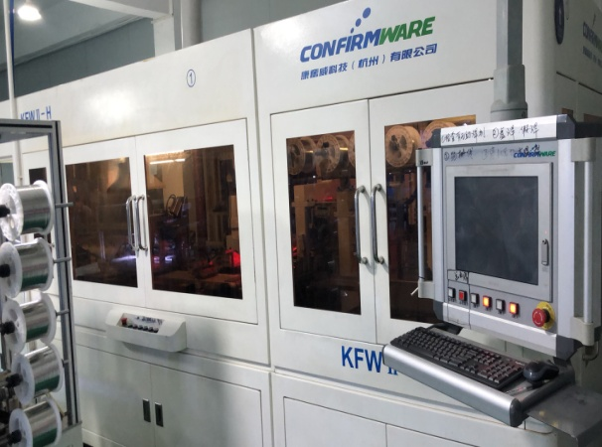
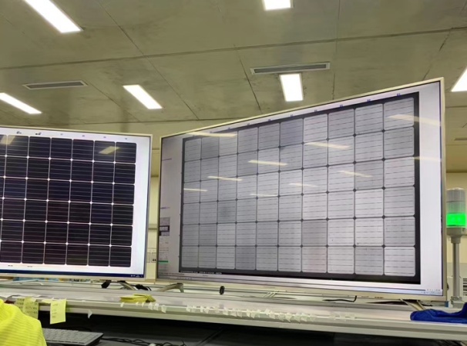
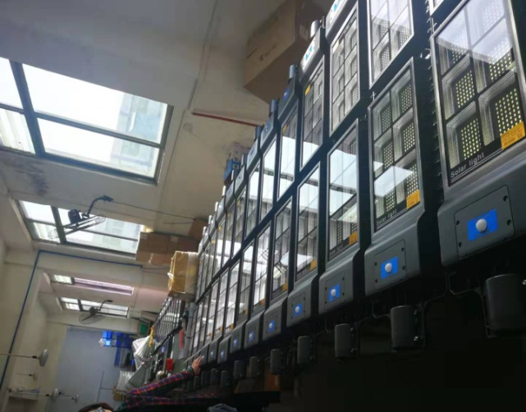
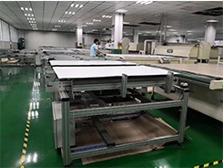
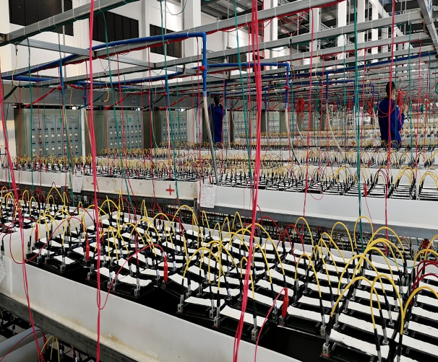
SPECIALIZED PRODUCTION
Cell sorting
Automatic series welder
Test before lamination
Fully automatic lamination of solar panels
Solar street light assembly
Battery charging

Slide 7
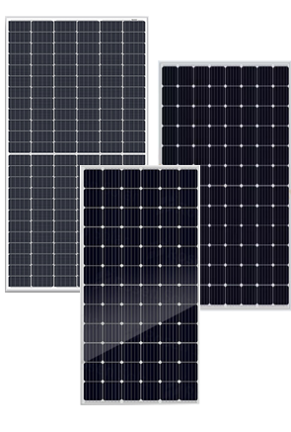
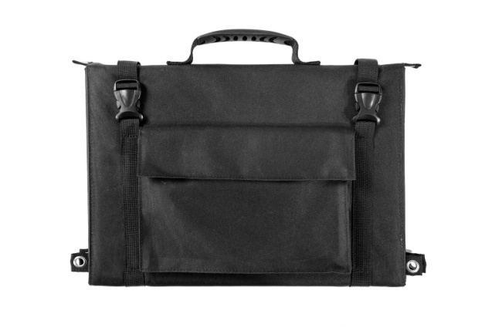
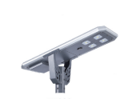
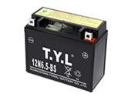
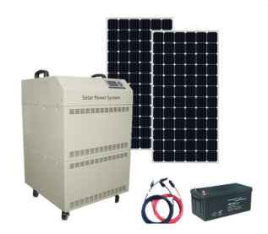
Product CATEGORY
PV Module
Solar Folding Bag
Product Category
Solar Street Light
Energy Storage Battery
Off-Grid Solar System

Slide 8
Monocrystalline Solar Module
Maximum Limited Space
72-cell module power output up to 400W.
Maximum Energy Harvest
Impedance matching technology eliminates mismatch loses, more power from each module bin.
High Efficiency
High module conversion efficiency, through innovative manufacturing technology.
Low-light Performance
Advanced glass and solar cell surface texturing allow for excellent performance in low-light environment.
Severe Weather Resilience
Certified to withstand: wind load(2400 Pascal) and snow load(5400 Pascal).
Higher quality assurance
100% EL test before and after lamination, and finished products EL test, providing higher quality assurance.

Slide 9
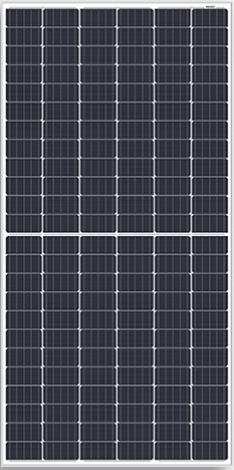
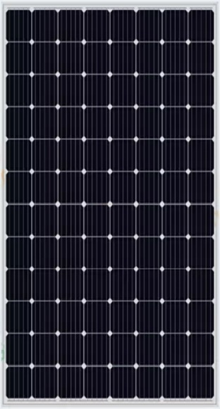
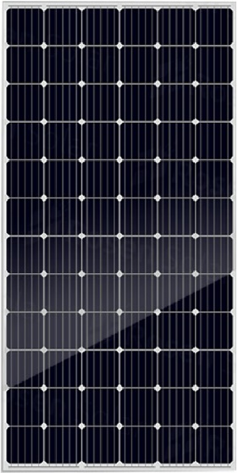
Monocrystalline solar Module
Monocrystalline Solar Module Parameters Table
Dimension | Module | Pmax | Vmp | Voc | Imp | Isc | Weight
1956*1320*40MM | TYL500MA | 500W | 49.10V | 58.92V | 10.18A | 10.68A | 27.5Kg
1979*1002*40MM | TYL400MH2 | 400W | 41.17V | 49.5V | 9.72A | 10.26A | 22.3Kg
1979*1002*40MM | TYL390MH2 | 390W | 40.85V | 48.91V | 9.62A | 10.16A | 22.3Kg
1956*992*40MM | TYL380MA | 380W | 40.05V | 48.82V | 9.49A | 9.99A | 21.5Kg
1956*992*40MM | TYL360MA | 360W | 39.09V | 47.77V | 9.21A | 9.71A | 21.5Kg
1665*1002*35MM | TYL340MH2 | 340W | 34.63V | 41.36V | 9.82A | 10.46A | 18.7Kg
1665*1002*35MM | TYL330MH2 | 330W | 34.13V | 40.84V | 9.67A | 10.30A | 18.7Kg
1640*992*35MM | TYL320MA | 320W | 33.87V | 41.30V | 9.45A | 9.97A | 18.5Kg
1480*680*35MM | TYL200MA | 200W | 20.85V | 24.90V | 9.60A | 10.36A | 11.1Kg
1480*680*35MM | TYL190MA | 190W | 20.55V | 24.65V | 9.49A | 10.24A | 11.1Kg
1320*680*30MM | TYL180MA | 180W | 18.53V | 22.23V | 9.71A | 10.48A | 9.66Kg
1320*680*30MM | TYL170MA | 170W | 18.26V | 21.91V | 9.30A | 10.04A | 9.66Kg
1320*680*30MM | TYL160MA | 160W | 18.00V | 21.60V | 8.88A | 9.59A | 9.66Kg
Tongli can offer 5w to 500W monocrystalline solar panel with high quality and low price. OEM services is available.

Slide 10
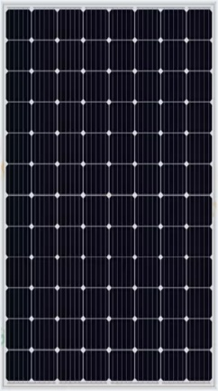
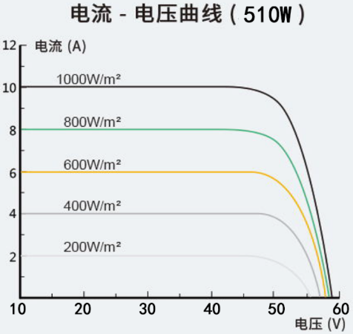
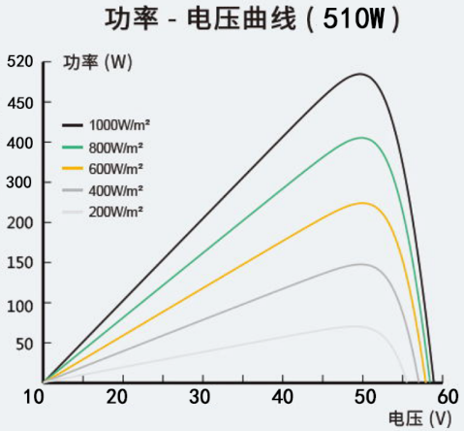
TYL480-515MA-96 Monocrystalline Solar Module
Module | TYL480MA | TYL490MA | TYL500MA | TYL505MA | TYL510MA | TYL515MA
Maximum Power(Pmax)[W] | 480 | 490 | 500 | 505 | 510 | 515
Open Circuit Voltage(Voc)[V] | 58.44 | 58.68 | 58.92 | 59.16 | 59.40 | 59.64
Maximum Power Voltage(Vmp)[V] | 48.70 | 48.90 | 49.10 | 49.30 | 49.50 | 49.70
Short Circuit Current(Isc)[A] | 10.35 | 10.52 | 10.68 | 10.75 | 10.81 | 10.87
Maximum Power Current (Imp)[A] | 9.86 | 10.02 | 10.18 | 10.24 | 10.30 | 10.36
Module Efficiency STC[%] | 18.92 | 19.32 | 19.71 | 19.91 | 20.10 | 20.50
Power Tolerance |  | 0∽+5W
Temperature Coefficient of Isc |  | +0.041%/℃
Temperature Coefficient of Voc |  | -0.393%/℃
Temperature Coefficient of Pmax |  | -0.310%/℃
STC |  | Irradiance1000W/m²，Cell Temperature25℃，AM1.5G
Maximum System Voltage |  | 1000V/1500V DC(IEC)
Operating Temperature |  | -40℃∽+85℃
Type of Cell Mono 156.75mm×156.75mm 96/8×12
Weight |  | 27.5Kg±3%
Dimension 1956±2mm×1320±2mm×40±1mm
Packging |  | Each box capacity: 27 pcs

Slide 11
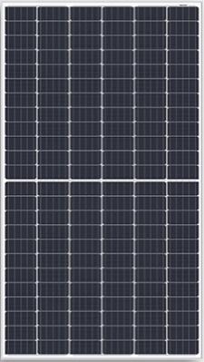
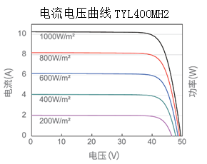
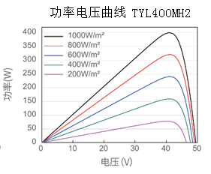
TYL390-410MH2-72 Monocrystalline Solar Module
Module | TYL390MH2 |  | TYL395MH2 | TYL400MH2 | TYL405MH2 | TYL410MH2
Maximum Power(Pmax)[W] | 390 |  | 395 | 400 | 405 | 410
Open Circuit Voltage(Voc)[V] | 48.91 |  | 49.21 | 49.5 | 49.81 | 50.12
Maximum Power Voltage(Vmp)[V] | 40.55 |  | 40.85 | 41.17 | 41.46 | 41.76
Short Circuit Current(Isc)[A] | 10.16 |  | 10.21 | 10.26 | 10.32 | 10.37
Maximum Power Current (Imp)[A] | 9.62 |  | 9.57 | 9.72 | 9.77 | 9.82
Module Efficiency STC[%] | 19.6 |  | 19.9 | 20.2 | 20.5 | 20.8
Power Tolerance |  |  | 0∽+5W
Temperature Coefficient of Isc |  |  | +0.051%/℃
Temperature Coefficient of Voc |  |  | -0.289%/℃
Temperature Coefficient of Pmax |  |  | -0.350%/℃
STC |  |  | Irradiance1000W/m²，Cell Temperature25℃，AM1.5G
Maximum System Voltage |  |  | 1000V/1500V DC(IEC)
Operating Temperature |  |  | -40℃∽+85℃
Type of Cell Mono 156.75mm×78.375mm 72/6×12
Weight |  |  | 22.3Kg±3%
Dimension 1979±2mm×1002±2mm×40±1mm
Packging |  |  | Each box capacity: 27 pcs

Slide 12
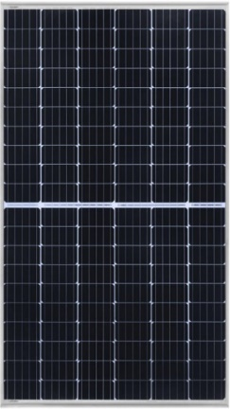
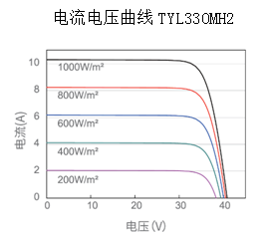
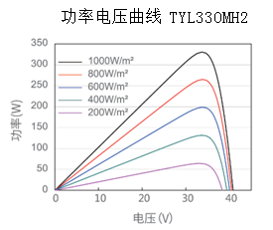
TYL320-340MH2-60 Monocrystalline Solar Module
Module | TYL320MH2 |  | TYL325MH2 | TYL330MH2 | TYL335MH2 | TYL340MH2
Maximum Power(Pmax)[W] | 320 |  | 325 | 330 | 335 | 340
Open Circuit Voltage(Voc)[V] | 40.27 |  | 40.56 | 40.84 | 41.12 | 41.36
Maximum Power Voltage(Vmp)[V] | 33.62 |  | 33.87 | 34.13 | 34.36 | 34.63
Short Circuit Current(Isc)[A] | 10.16 |  | 10.23 | 10.30 | 10.38 | 10.46
Maximum Power Current (Imp)[A] | 9.52 |  | 9.60 | 9.67 | 9.75 | 9.82
Module Efficiency STC[%] | 19.2 |  | 19.5 | 19.8 | 20.1 | 20.4
Power Tolerance |  |  | 0∽+5W
Temperature Coefficient of Isc |  |  | +0.051%/℃
Temperature Coefficient of Voc |  |  | -0.289%/℃
Temperature Coefficient of Pmax |  |  | -0.350%/℃
STC |  |  | Irradiance1000W/m²，Cell Temperature25℃，AM1.5G
Maximum System Voltage |  |  | 1000V/1500V DC(IEC)
Operating Temperature |  |  | -40℃∽+85℃
Type of Cell Mono 156.75mm×78.375mm 120/6×10
Weight |  |  | 18.7Kg±3%
Dimension 1665±2mm×1000±2mm×40±1mm
Packging |  |  | Each box capacity: 31 pcs

Slide 13
Polycrystalline Solar Module
Maximum Energy Harvest
Impedance matching technology eliminates mismatch loses, more power from each module bin.
Low-light Performance
Advanced glass and solar cell surface texturing allow for excellent performance in low-light environment.
Severe Weather Resilience
Certified to withstand: wind load(2400 Pascal) and snow load(5400 Pascal).
Higher quality assurance
100% EL test before and after lamination, and finished products EL test, providing higher quality assurance.

Slide 14
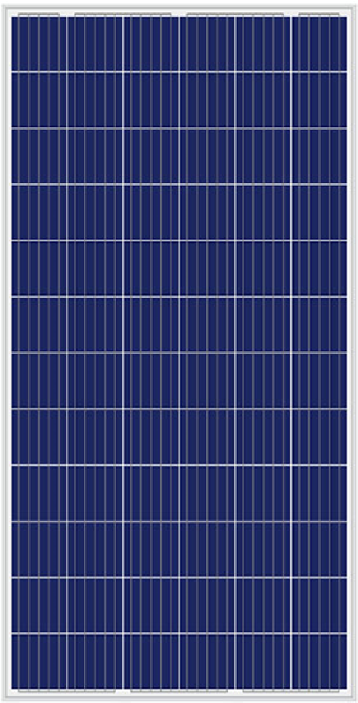
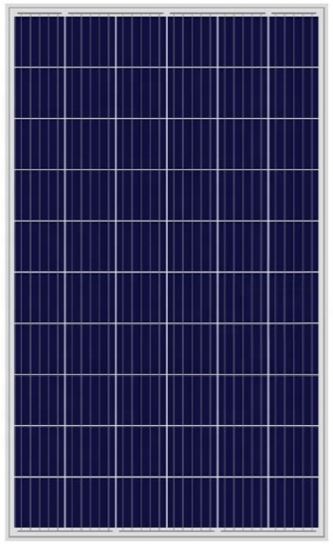
Polycrystalline solar Module
Polycrystalline Solar Module Parameters Table
Dimension | Module | Pmax | Vmp | Voc | Imp | Isc | Weight
1956*992*40MM | TYL360PA | 360W | 39.08V | 48.05V | 9.22A | 9.65A | 21.5Kg
1956*992*40MM | TYL350PA | 350W | 38.56V | 47.35V | 9.08A | 9.53A | 21.5Kg
1956*992*40MM | TYL340PA | 340W | 38.04V | 46.65V | 8.94A | 9.41A | 21.5Kg
1956*992*40MM | TYL330PA | 330W | 37.52V | 45.95V | 8.80A | 9.29A | 21.5Kg
1956*992*40MM | TYL320PA | 320W | 37.04V | 45.32V | 8.64A | 9.16A | 21.5Kg
1956*992*40MM | TYL310PA | 310W | 36.52V | 44.62V | 8.50A | 9.01A | 21.5Kg
1640*992*35MM | TYL295PA | 295W | 32.78V | 39.99V | 9.00A | 9.51A | 18.5Kg
1640*992*35MM | TYL290PA | 290W | 32.44V | 39.69V | 8.94A | 9.44A | 18.5Kg
1640*992*35MM | TYL285PA | 285W | 32.10V | 39.27V | 8.88A | 9.37A | 18.5Kg
1640*992*35MM | TYL280PA | 280W | 31.75V | 38.91V | 8.82A | 9.30A | 18.5Kg
1640*992*35MM | TYL275PA | 275W | 31.40V | 38.55V | 8.76A | 9.23A | 18.5Kg
1640*992*35MM | TYL270PA | 270W | 31.15V | 38.19V | 8.67A | 9.17A | 18.5Kg
Tongli can offer 5w to 360W polycrystalline solar panel with high quality and low price. OEM services is available.

Slide 15
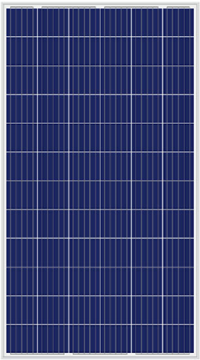
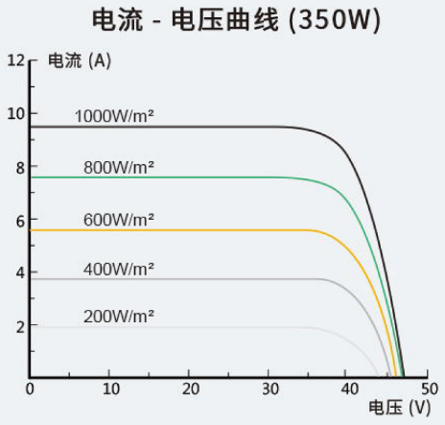
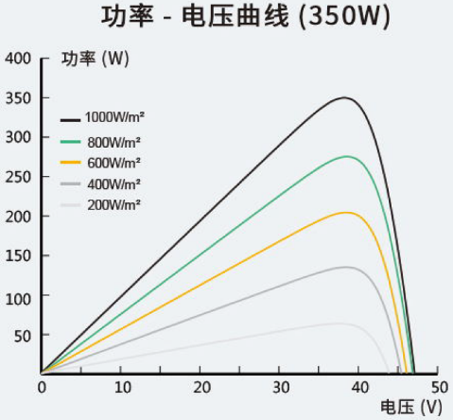
TYL310-360PA-72 Polycrystalline Solar Module
Module | TYL310PA | TYL320PA | TYL330PA | TYL340PA | TYL350PA | TYL360PA
Maximum Power(Pmax)[W] | 310 | 320 | 330 | 340 | 350 | 360
Open Circuit Voltage(Voc)[V] | 44.62 | 45.32 | 45.95 | 46.65 | 47.35 | 48.05
Maximum Power Voltage(Vmp)[V] | 36.52 | 37.04 | 37.52 | 38.04 | 38.56 | 39.08
Short Circuit Current(Isc)[A] | 9.01 | 9.16 | 9.29 | 9.41 | 9.41 | 9.65
Maximum Power Current (Imp)[A] | 8.50 | 8.64 | 8.80 | 8.94 | 8.94 | 9.22
Module Efficiency STC[%] | 15.97 | 16.48 | 17.00 | 17.51 | 18.03 | 18.54
Power Tolerance |  | 0∽+5W
Temperature Coefficient of Isc |  | +0.041%/℃
Temperature Coefficient of Voc |  | -0.393%/℃
Temperature Coefficient of Pmax |  | -0.310%/℃
STC |  | Irradiance1000W/m²，Cell Temperature25℃，AM1.5G
Maximum System Voltage |  | 1000V/1500V DC(IEC)
Operating Temperature |  | -40℃∽+85℃
Type of Cell Poly 156.75mm×156.75mm 72/6×12
Weight |  | 21.5Kg±3%
Dimension 1956±2mm×992±2mm×40±1mm
Packging |  | Each box capacity: 27 pcs

Slide 16
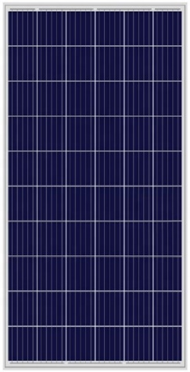
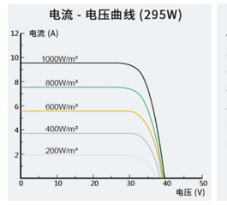
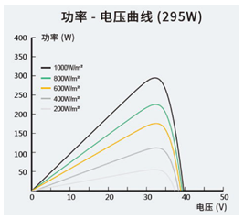
TYL270-295PA-60 Polycrystalline Solar Module
Module | TYL270PA | TYL275PA | TYL280PA | TYL285PA | TYL290PA | TYL295PA
Maximum Power(Pmax)[W] | 270 | 275 | 280 | 285 | 290 | 295
Open Circuit Voltage(Voc)[V] | 38.19 | 38.55 | 38.91 | 38.27 | 39.69 | 39.99
Maximum Power Voltage(Vmp)[V] | 31.15 | 31.40 | 31.75 | 32.10 | 32.44 | 32.78
Short Circuit Current(Isc)[A] | 9.17 | 9.23 | 9.30 | 9.37 | 9.44 | 9.51
Maximum Power Current (Imp)[A] | 8.67 | 8.76 | 8.82 | 8.88 | 8.94 | 9.00
Module Efficiency STC[%] | 16.60 | 16.90 | 17.21 | 17.52 | 17.83 | 18.13
Power Tolerance |  | 0∽+5W
Temperature Coefficient of Isc |  | +0.041%/℃
Temperature Coefficient of Voc |  | -0.393%/℃
Temperature Coefficient of Pmax |  | -0.310%/℃
STC |  | Irradiance1000W/m²，Cell Temperature25℃，AM1.5G
Maximum System Voltage |  | 1000V/1500V DC(IEC)
Operating Temperature |  | -40℃∽+85℃
Type of Cell Poly 156.75mm×156.75mm 60/6×10
Weight |  | 18.5Kg±3%
Dimension 1640±2mm×992±2mm×35±1mm
Packging |  | Each box capacity: 31 pcs

Slide 17
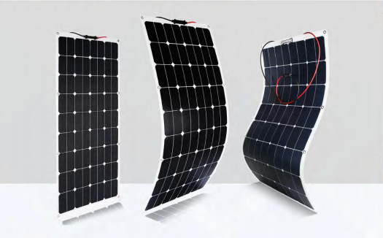
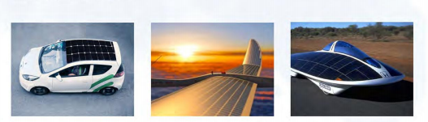
Flexible Solar Panel
Function Features
The flexible sunpower solar panel conversion efficiency is 23.5%, and the lifetime is about 10 years, which they below excellent performances: High temperature and low light performance, bypass diodes for shadow tolerance, water-proof, UV-proof, Dust-proof, surface with high transmittance ETFE, back with high waterproof TPT, lightweight, flexible and portable.

Slide 18
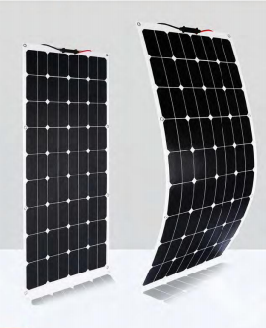
Flexible Solar Panel
Flexible Solar Panel Parameters Table
Dimension | Module | Pmax | Vmp | Voc | Imp | Isc
1580*808*3MM | TYL-ETPV200 | 200W | 36.0V | 43.2 V | 5.55 A | 5.99 A
1470*670*3MM | TY-ETPV180 | 180W | 18.0V | 21.6V | 10.00A | 10.56A
1320*670*3MM | TYL-ETPV150 | 150W | 16.0V | 21.6V | 9.37A | 10.12A
1180*540*3MM | TYL-ETPV100 | 100W | 18.0V | 21.6V | 5.56A | 5.89A
1050*540*3MM | TYL-ETPV090 | 90W | 16.0V | 19.2V | 5.63A | 6.13A
830*510*3MM | TYL-ETPV075 | 75W | 18.0V | 21.6V | 4.16A | 4.41A
630*540*3MM | TYL-ETPV050 | 50W | 18.0V | 21.6V | 2.77A | 2.99A
570*410*3MM | TYL-ETPV030 | 30W | 18.0V | 21.6V | 1.66A | 1.79A

Slide 19
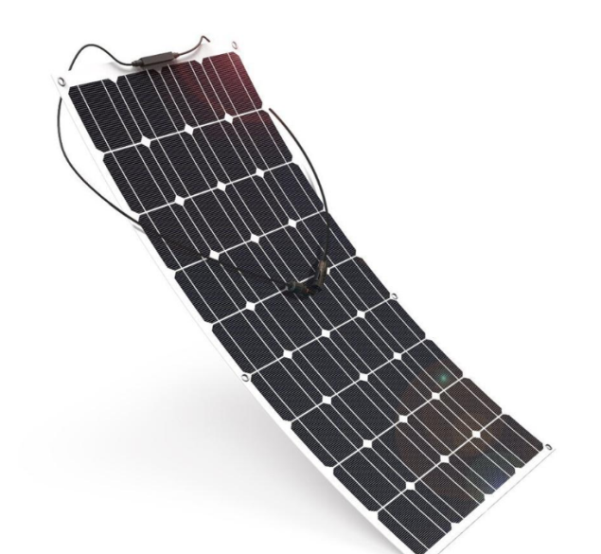
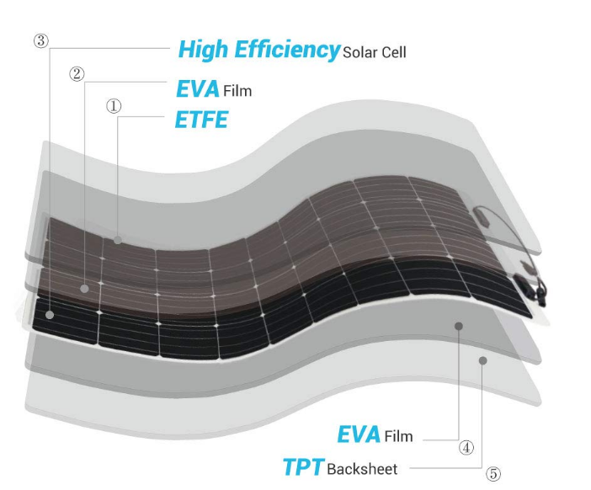
TYL-ETPV150
Quick Details
Place of Origin: Guangdong, China
Model Number: TYL-ETPV150
Size: 1480*670*3mm
Certificate: IEC/ISO/CE
Weight: 3.3KG
Frame Color: Silvery
Maximum Power: 150W
Open-circuit Voltage: 22.3V
Brand Name: TYL
Type: Flexible
Panel Efficiency: 23.70%
Warranty: 1 Years
OEM Order: Acceptable
Voltage at Pmax: 18.5V
Cells Efficiency: 23.70%
Application: Camping
TYL-ETPV200
Quick Details
Place of Origin: Guangdong, China
Model Number: TYL-ETPV200
Size: 1580*808*3mm
Certificate: ISO/CE
Product Name: Flexible Solar Panel
Voltage: 36V/24V/18V
Solar Cell: 72 cells(6*12)
Open-circuit Voltage: 43.2V
Open-circuit Current : 5.99A
Brand Name: TYL
Type: Flexible
Panel Efficiency: 19.60%
Warranty: 3 Years
Power: 200W
Weight: 5.6KG
System Voltage: 600V
Frame: Aluminum Alloy

Slide 20


TYL-ETFE180
Quick Details
Place of Origin: Guangdong, China
Model Number: TYL-ETFE180
Size: 1470*670*3mm
Certificate: ISO/CE/IEC
Power: 180W
Maximum Working Voltage: 18V
Open-circuit Voltage: 21.6V
Open-circuit Current : 10.56A
Brand Name: TYL
Type: Mono
Panel Efficiency: 18.20%
Warranty: 2 Years
Effectiveness: 18.2%
System Voltage: 600V
Maximum Working Current: 10A
TYL-100EFMA
Quick Details
Place of Origin: Guangdong, China
Model Number: TYL-100EFMA
Size: 1180*540*3mm
Certificate: ISO/CE/IEC
Power: 100W
Maximum Working Voltage: 18V
Open-circuit Voltage: 21.6V
Open-circuit Current : 5.89A
Brand Name: TYL
Type: Mono
Panel Efficiency: 15.70%
Warranty: 2 Years
Effectiveness: 15.70%
System Voltage: 600V
Maximum Working Current: 5.56A

Slide 21

Solar Folding Bag
Features and Advantages
Features:
①It is convenient, charge your car/truck batteries anytime anywhere by facing to sunlight.
②Directly charge your power storage devices within a short time.
③Lightweight, easy carrying.
Advantages:
①High efficiency, Efficiency 22%-24%.
②Various application, such as 12V batteries, smartphones , power banks, tablets etc.
③Portable, lightweight and easy carrying.

Slide 22










Solar Folding Bag
Solar Folding Bag Parameters Table
Model | TYL-SFSP120-6 120W Six folds Abrazine SUNPOWER solar charger | TYL-SFSP100-2 100W Two folds Abrazine SUNPOWER solar charger | TYL-SFSP60-2 60W Two folds Abrazine SUNPOWER solar charger | TYL-FSP100-2 100W Two folds Abrazine PET solar charger | TYL-FSP50-2 50W Two folds Abrazine PET solar charger
Appearance
Color | Camouflage colors/Black/Other Customization | Black/Other Customization | Black/Other Customization | Black/Other Customization | Black/Other Customization
Peak Power | 120W | 100W | 50W | 100W | 50W
Cell | Mono19.2%above efficiency sunpower | Mono19.2%above efficiency sunpower | Mono19.2%above efficiency | Mono19.2%above efficiency | Mono19.2%above efficiency
Output | DC18V*6.6A&USB 5V*3.0A | DC18V*5.5A&USB 5V*3.0A | DC18V*3.4A&USB 5V*3.0A | DC18V*5.5A&USB 5V*3.0A | DC18V*2.7A&USB 5V*2.0A
Unfold Dimension | 1810*405*6MM | 1120*540*4MM | 840*416*4MM | 1040*520*4MM | 900*450*4MM
Fold Dimension | 405*280*48mm | 560*540*8MM | 420*416*8MM | 520*510*8MM | 450*450*8MM
Fold Count | Six | Two | Two | Two | Two

Slide 23


TYL-SFSP120-6
Quick Details
Place of Origin: Guangdong, China
Model Number: TYL-SFSP120-6
Size: 260*350*80mm
Certificate: IEC/ISO/CE
Weight: 4.3KG
Color: Black/Camouflage
Maximum Power: 120W
Open-circuit Voltage: 22.3V
Power Temperature Coefficient: -0.38 %/℃
Brand Name: TYL
Type: Flexible
Panel Efficiency: 23.70%
Warranty: 1 Years
OEM Order: Acceptable
Voltage at Pmax: 18.5V
Cells Efficiency(%): 23.7%
Application: Camping
Type Mono
Power 120W
Fold Size 260mm*350mm*80mm
Open Area 1560mm*350mm
Effectiveness 23.7%
Maximum Working Voltage 18.5V
Maximum Working Current 6.49A
Open Circuit Voltage 22.3V
Open Circuit Current 6.40A
System Voltage 600V

Slide 24

Solar Street Light
Advantages
Solar street light can be installed independently, no need to dig trenches, buried lines, backfill, save construction costs.
Solar street light can realize automatic control, without personnel management, saving management expenses.
Solar street light demand energy from the sun and do not use conventional electric energy, saving operating costs.

Slide 25

Solar Street Light
Solar Street Light Parameters Table
Model | Light Power | Module Power | Battery Capacity | Dimension | Light Source Qty
LC-YTDC-020 | 20W | 50W | 185WH | 900*385*43mm | SMD5050 24PCS
LC-YTDC-030 | 30W | 60W | 256WH | 1060*385*43mm | SMD5050 36PCS
LC-YTDC-040 | 40W | 70W | 320WH | 1210*385*43mm | SMD5050 48PCS
LC-YTDC-050 | 50W | 80W | 400WH | 1390*385*43mm | SMD5050 60PCS
LC-YTDC-060 | 60W | 90W | 444WH | 1535*385*43mm | SMD5050 72PCS
LC-YTDC-070 | 70W | 100W | 555WH | 1690*385*43mm | SMD5050 84PCS

Slide 26



Energy Storage Battery
VALVE-Regulated
Lead-Acid Battery

Slide 27



Energy Storage Battery

Slide 28


Off-Grid Solar System
Advantages
1. All systems has LCD digital display. (Can see the system working condition, such as system voltage, system power, charge current, etc).
2. All systems have AC and DC output, and also have AC charger function for backup.
3. When the electricity off, it can switch automatically and take use of battery power to run load. When power on it also can switch. automatically and take use of main power(utility electric/generator electric), at the same time charging battery.
4. The inverter is pure sine wave inverter, it can load inductive load such as air condition very smooth.
5. Each component has single chip detect which protected itself.(Over-voltage protection, low-voltage alarm, overload protection, over-heat protection, short-circuit protection, etc)

Slide 29


TYL 220V2000W Off-Grid Solar Power System Home

Slide 30





Product details
PV Combiner Box
IP65 design, waterproof, anti dust and anti ultraviolet.
Strict test for high and low temperature, used widely.
The simple installation, the simplified system wiring, the convenient wiring.
Solar Panel
Quality Assurance.
Anti-reflection Glass.
Power Tolerance ±3%.
Waterproof Performance.
Strong Compressive Strength.
GEL Battery
Solve electrolyte stratification, sulfuric acid evenly distributed.
The sillica gel electrolyte lead-acid batteries can be so deep discharge, thus greatly extending the cycle life of the battery.
The battery float current is small.
Low self-discharge rate of the battery.
Solar Inverter
Grid electricity and battery power priority is optional.
Higher and adjustable charging current.
Intelligent protection, higher class of security.
Bypass charging function, AC charge available when the unit off.
MPPT Solar Charger Controller
Intelligent Maximum Power Point Tracking technology increases efficiency 25%-30%.
Three-stage charging optimizes battery performance.
Maximum charging current up to 45A/60A/80A/100A.
Maximum efficiency up to 98%.

Slide 31









Engineering Projects
Tongcheng 1MW agricultural and photovoltaic complementary power station
Anding Nursing Home 70KW
The first high school of Pingjiang 70KW Photovoltaic Project
Solar carport power station
Jiangmen 360KW Photovoltaic Power Station
5KW container mobile factory off-grid power generation system
Zhongshan 65KW Photovoltaic Power Station
Nansha Decheng International Co., Ltd. 420KW photovoltaic power station
LV Global Flagship Store Solar Power Service

Slide 32
CHOOSE US
03
Cooperation guarantee
03
Tongli enjoys national intellectual property protection and has a high reputation in the industry.
Market guarantee
02
02
The photovoltaic market is currently undergoing rapid and benign development, with unlimited prospects.
T.Y.L
Products guarantee
01
The solar photovoltaic and photovoltaic series products are complete in categories and varieties. The products cover all aspects, fully meet the needs of different groups of people and families, and have a wide range of applications.
04
After sales guarantee
Tongli has professional after-sales service personnel and professional technical team 24 hours on standby to solve all kinds of problems for you.

